Slide 1
Travel Demand Model Updates: NCDOT
April 15, 2025

Slide 2
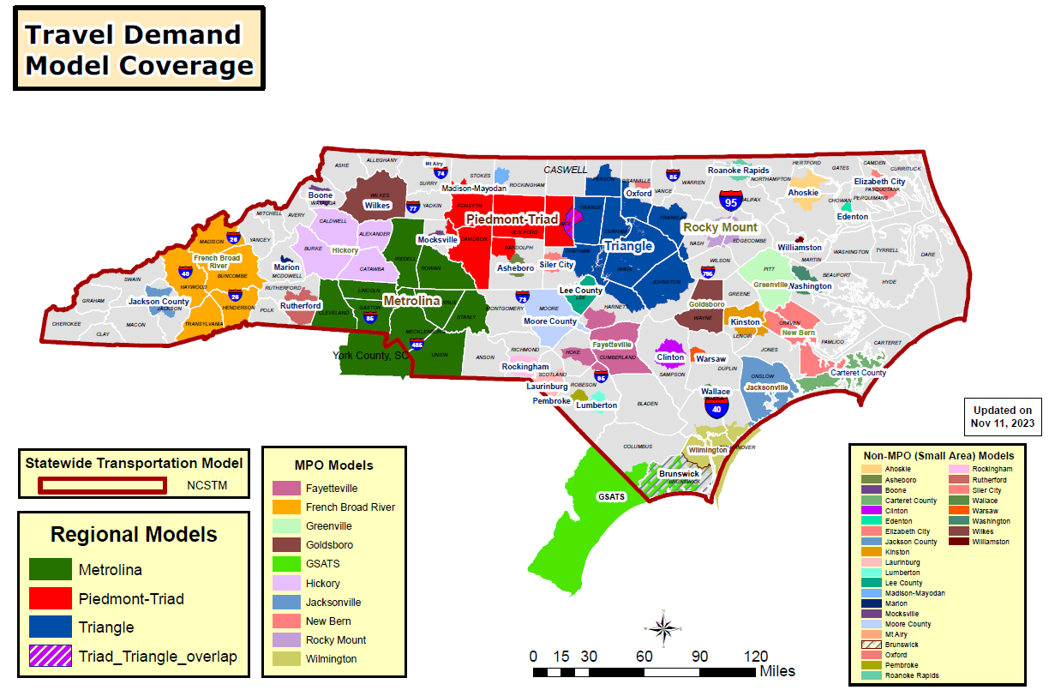

Slide 3
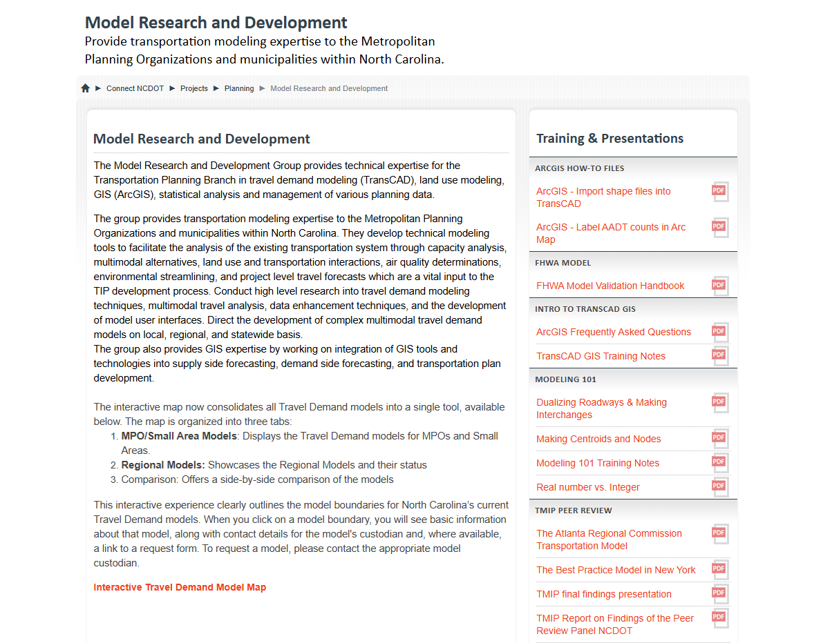

Slide 4
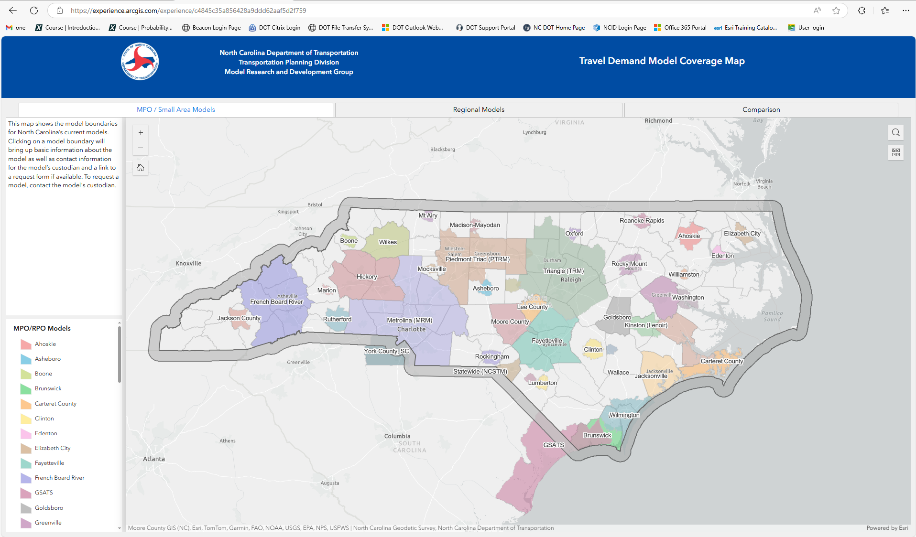

Slide 5
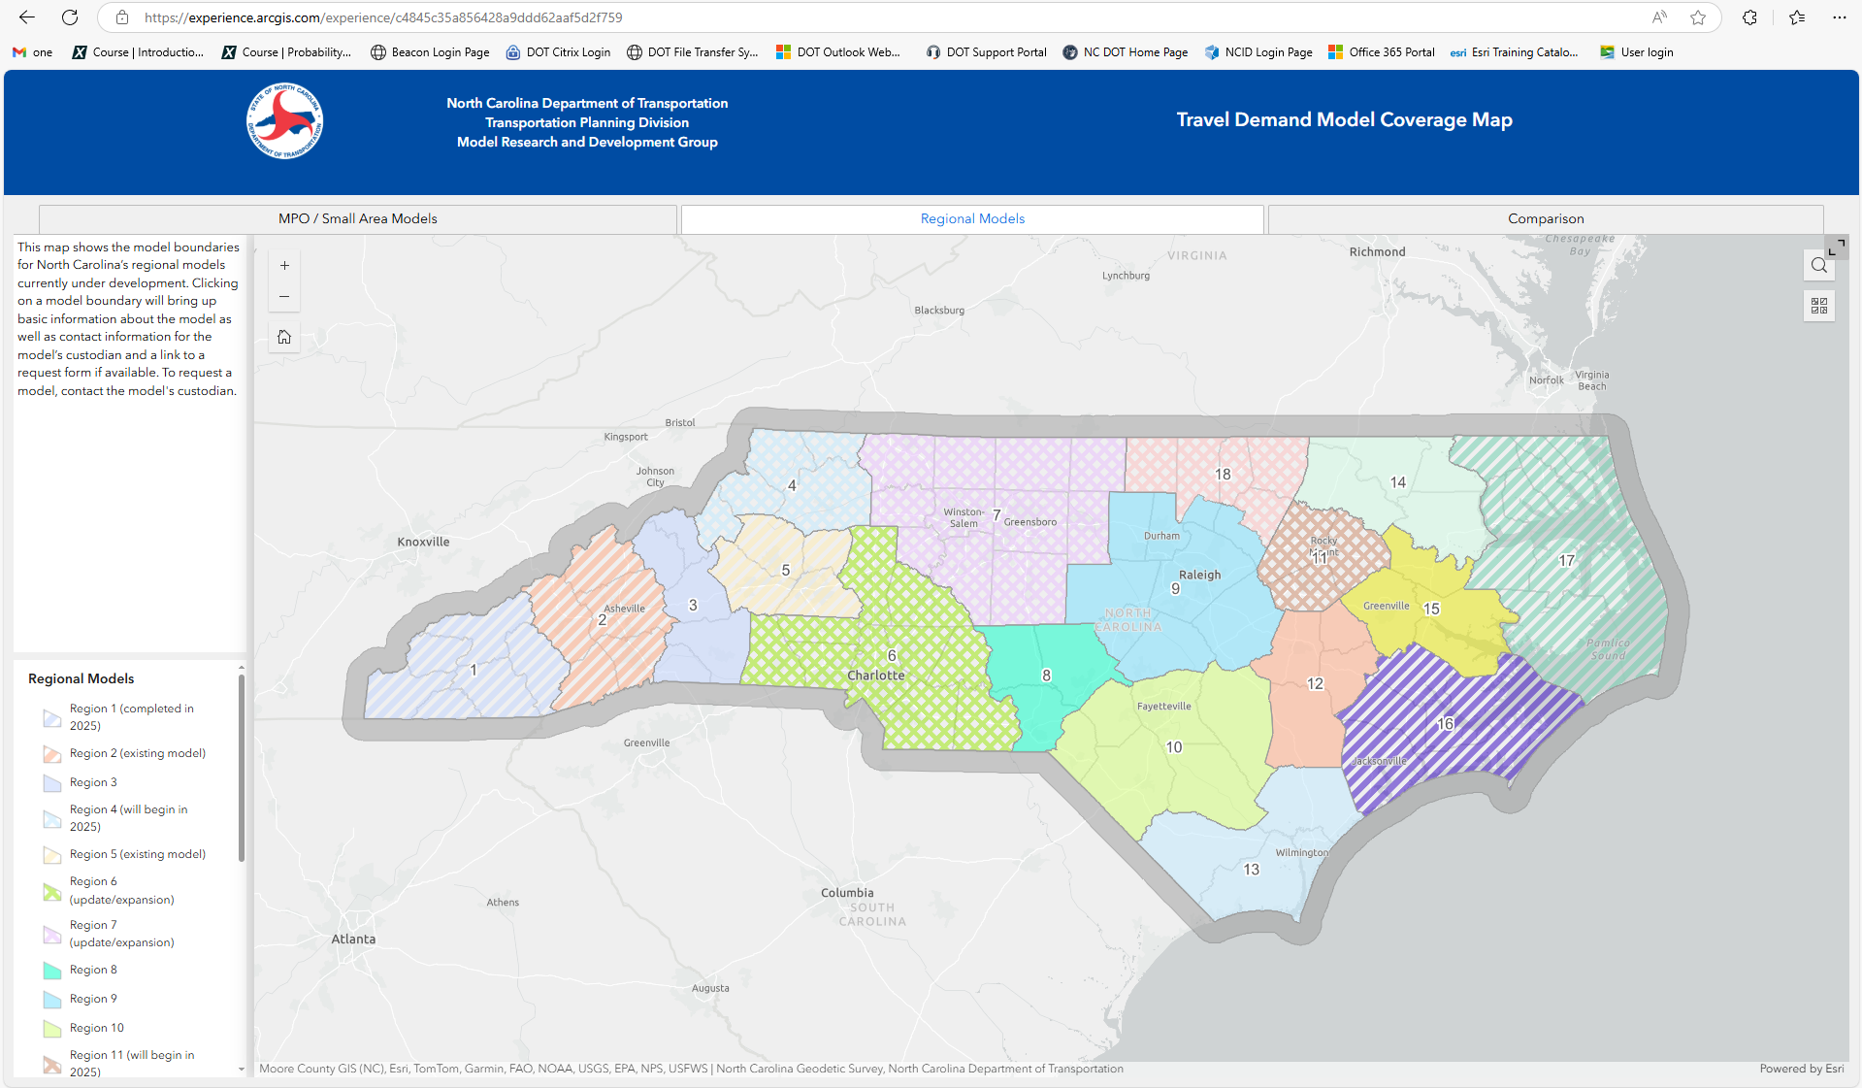

Slide 6
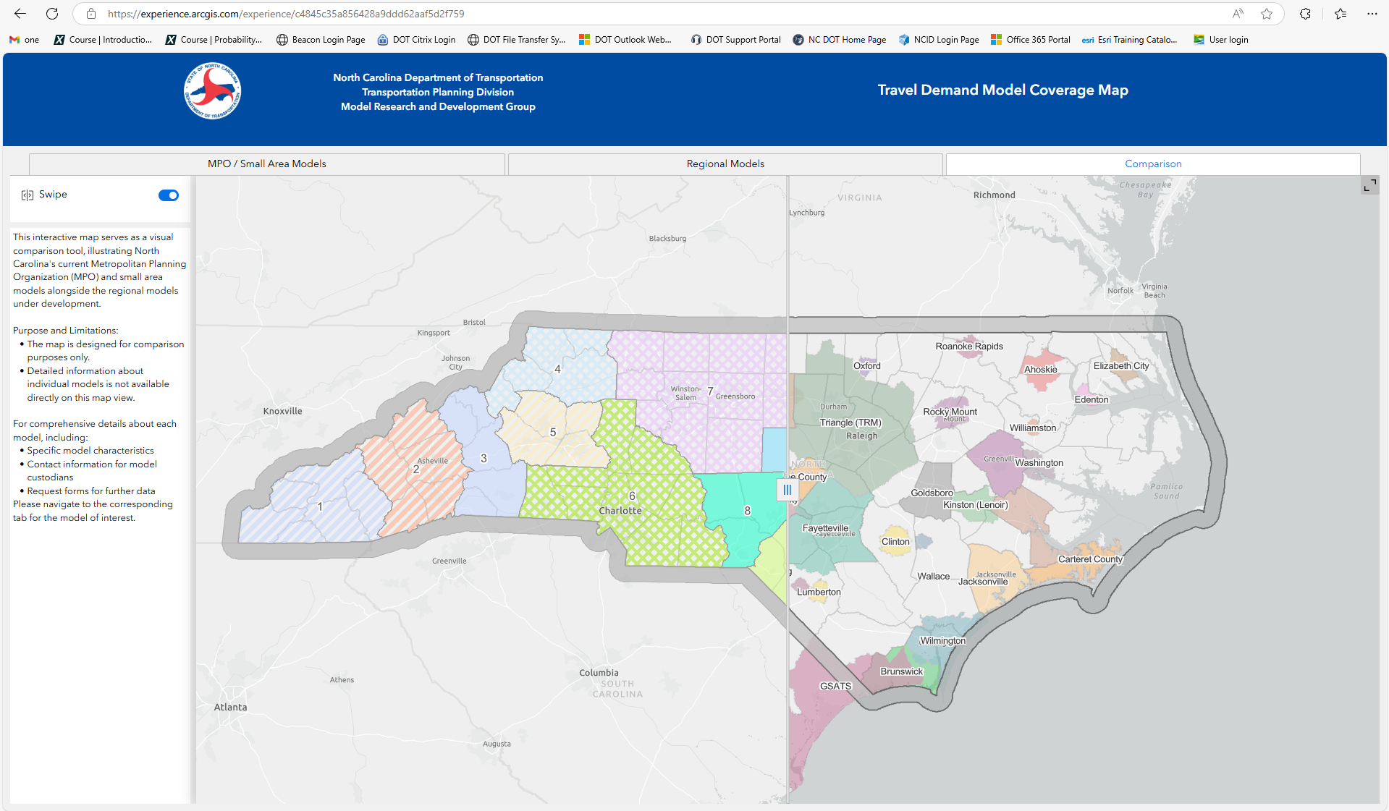

Slide 7
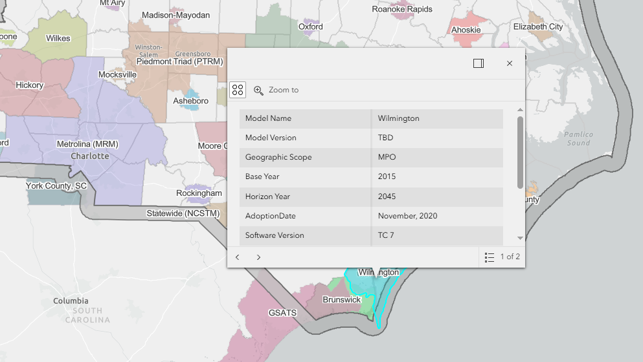

Slide 8
Current Model Updates
New Model :
Chatham County
Major Model Update :
NC Statewide Model (NCSTM)
Wilmington (WMPO)
Minor Model Update :
Moore County
French Broad River (FBRMPO)
Notes:
Harnett County-BY is complete. No progress in the past 6 months.
Faeytville and Wilmington_ Boundary and SE data

Slide 9
Current Model Updates
Completed:
NCRTDM Region 1
NCRTDM Region 17
NCRTDM Region 16
Under Development:
NCRTDM Region 18
Will Start Soon:
NCRTDM Region 4
Notes:
Harnett County-BY is complete. No progress in the past 6 months.
Faeytville and Wilmington_ Boundary and SE data

Slide 11
PDH Evaluation QR Code
https://forms.office.com/g/RbWeXUSeWZ?origin=lprLink

